Slide 1
Green university of Bangladesh
Computer science and engineering
Name : Nazifa Alam Nowrin
ID : 193002103
Course code: PHY104
Topic: Galvanometer

Slide 2
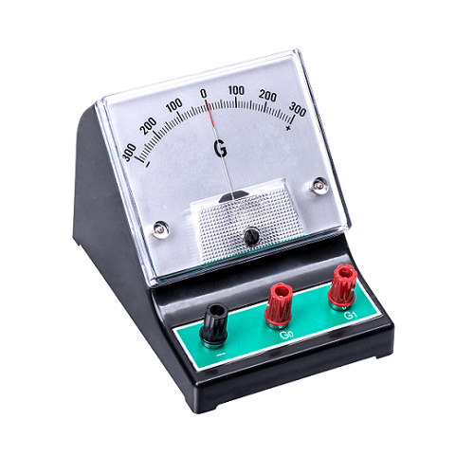

Slide 3
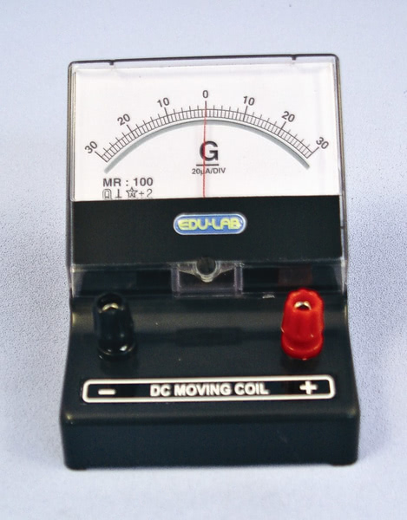
What is galvanometer?
A basic device for measuring a small electric current by means of a mechanical motion derived from electromagnetic forces produced by the current.

Slide 4
Principle Of Galvano Meter:
Galvanometer works on the principle of conversion of electrical energy into mechanical energy. When a current flows in a magnetic field it experiences a magnetic torque. If it is free to rotate under a controlling torque, it rotates through an angle proportional to the current flowing through it.

Slide 5
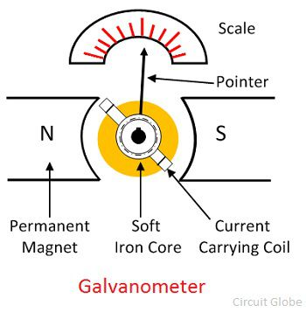

Slide 6
WORKING :
When a current passes through the galvanometer coil, it experiences a magnetic deflecting torque, which tends to rotate it from its rest position. As the coil rotates it produces a twist in the suspension strip. The twist in the strip produces an electric restoring torque. The coil rotates until the elastic restoring torque due to the strip does not equal and cancels the deflecting magnetic torque, then it attains equilibrium and stops rotating any furthers.

Slide 7
Applications:
It is used to detect the flow of the current’s direction within the circuit & also determine the null point.
It is used to determining the current.
By using this we can determine the voltage between two points.
They are used in control systems laser engraving, laser TVs, laser sintering etc.

Slide 8
Advantages and disadvantages :
The advantages of the galvanometer include the following.
It will not affect by a strong magnetic field
Accurate & reliable
Scales of this is uniform
The disadvantage of the galvanometer include the following.
Overload can spoil any kind of galvanometer.
The temperature change will cause a change within restoring torque.
It cannot be used for AC quantities measurement.

Slide 9
Thank you

Slide 10
Condition FOR SHM:
The system should haves restoring force.
The system should have inertia.
The system should be frictionless.

